Slide 1
Chapter 2.6 Creating High-Quality Code
CCSW 325 (Software Construction)
Notes:
Last Update: 22/8/2019
Version 1.0

Slide 2
Outline
Working Classes (Part 3 of 3)
Reasons to Create Class
Classes to Avoid

Slide 3

Reasons to Create Class
Model real-world objects
Create a class for each real-world object type that your program models
Modeling real-world objects might not be the only reason to create a class, but it’s still a good reason
Put the data needed for the object into the class, and then build service routines that model the behavior of the object

Slide 4
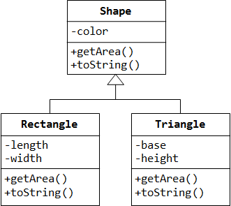
Reasons to Create Class
Model abstract objects
An object that isn’t a concrete, real-world object but that provides an abstraction of other concrete objects.
For example, the classic Shape object. Rectangle and Triangle really exist, but Shape is an abstraction of other specific shapes.

Slide 5

Reasons to Create Class
Reduce complexity
Create a class to hide information so that you won’t need to think about it, no need to know about its internal workings. Also, to minimize code size and improve maintainability

Slide 6

Reasons to Create Class
Isolate complexity
Complexity in all forms—complicated algorithms, large data sets, intricate communications protocols, and so on—is prone to errors
If an error does occur, it will be easier to find if it isn’t spread through the code but is localized within a class

Slide 7
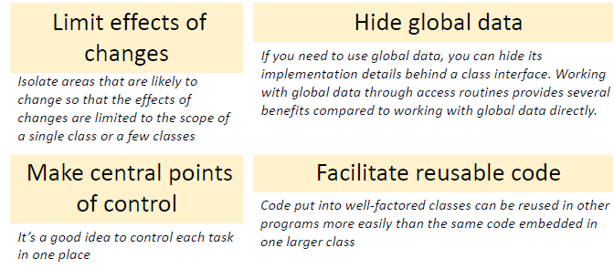
Reasons to Create Class

Slide 8

Class to Avoid
While classes in general are good, you can run into a few gotchas.
Notes:
It should be noted that a gotcha is not an error or an exception. It is a perfectly valid code that results in an incorrect output.

Slide 9
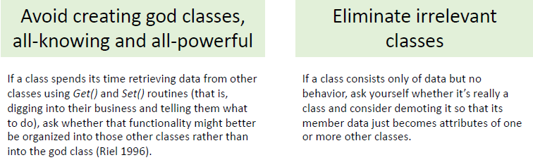
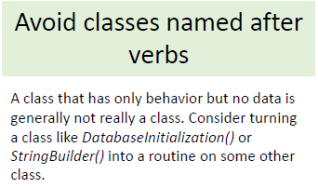
Classes to Avoid

Slide 10

Reading
Code Complete: A Practical Handbook of Software Construction, 2nd Edition, Steve McConnell.
Chapter 6

Slide 11

Any questions? ​
Please feel free to raise your hands and ask.

